Slide 1


An Autonomous & Flexible Edge code named “fornax”
Centaurus Edge Team

Slide 2

Agenda
Edge Use Cases
Requirements
Modeling & Design
POC (proof of concepts)

Slide 3
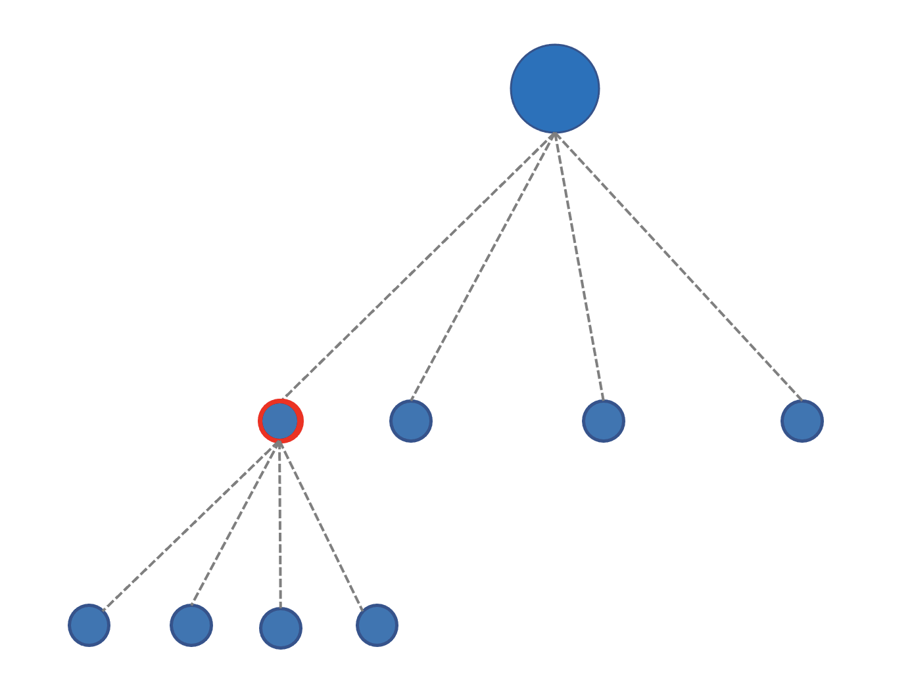
Edge Use Cases
IoT
“Industry 4.0”, smart factories
5G & Mobile Edge Computing

Slide 4

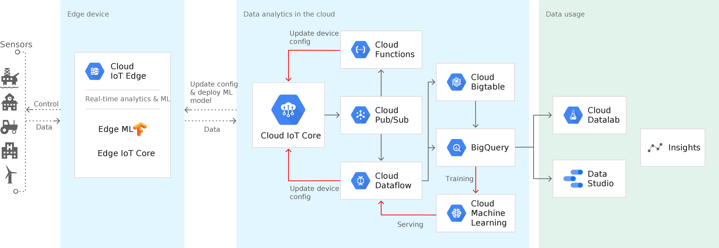
IoT Edge

Slide 5
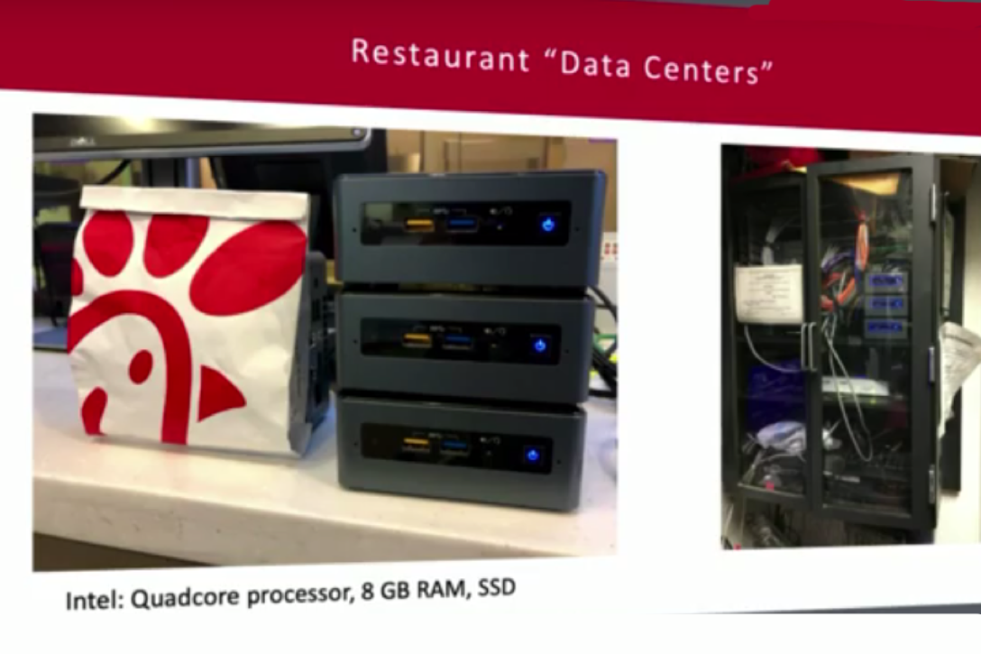
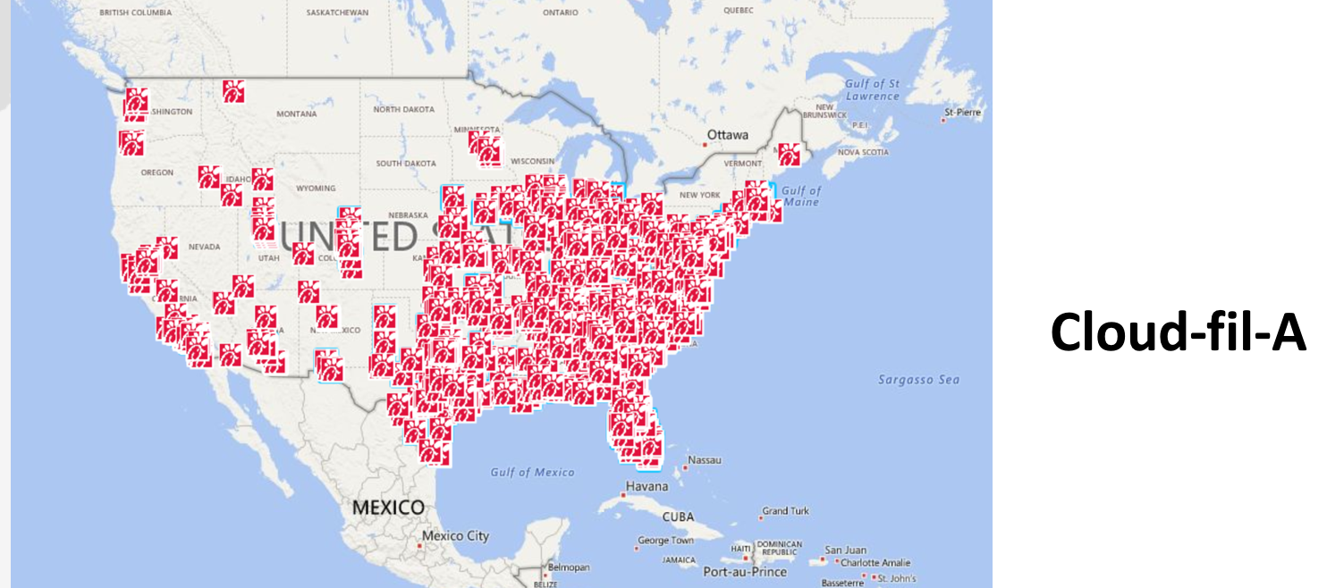
“many clusters”
https://medium.com/@cfatechblog/edge-ai-in-a-smarter-chick-fil-a-6e56fe026154

Slide 6
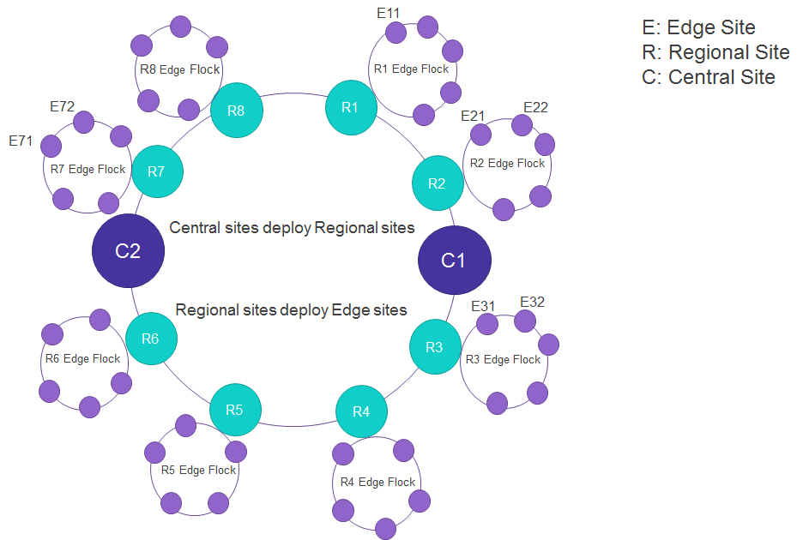
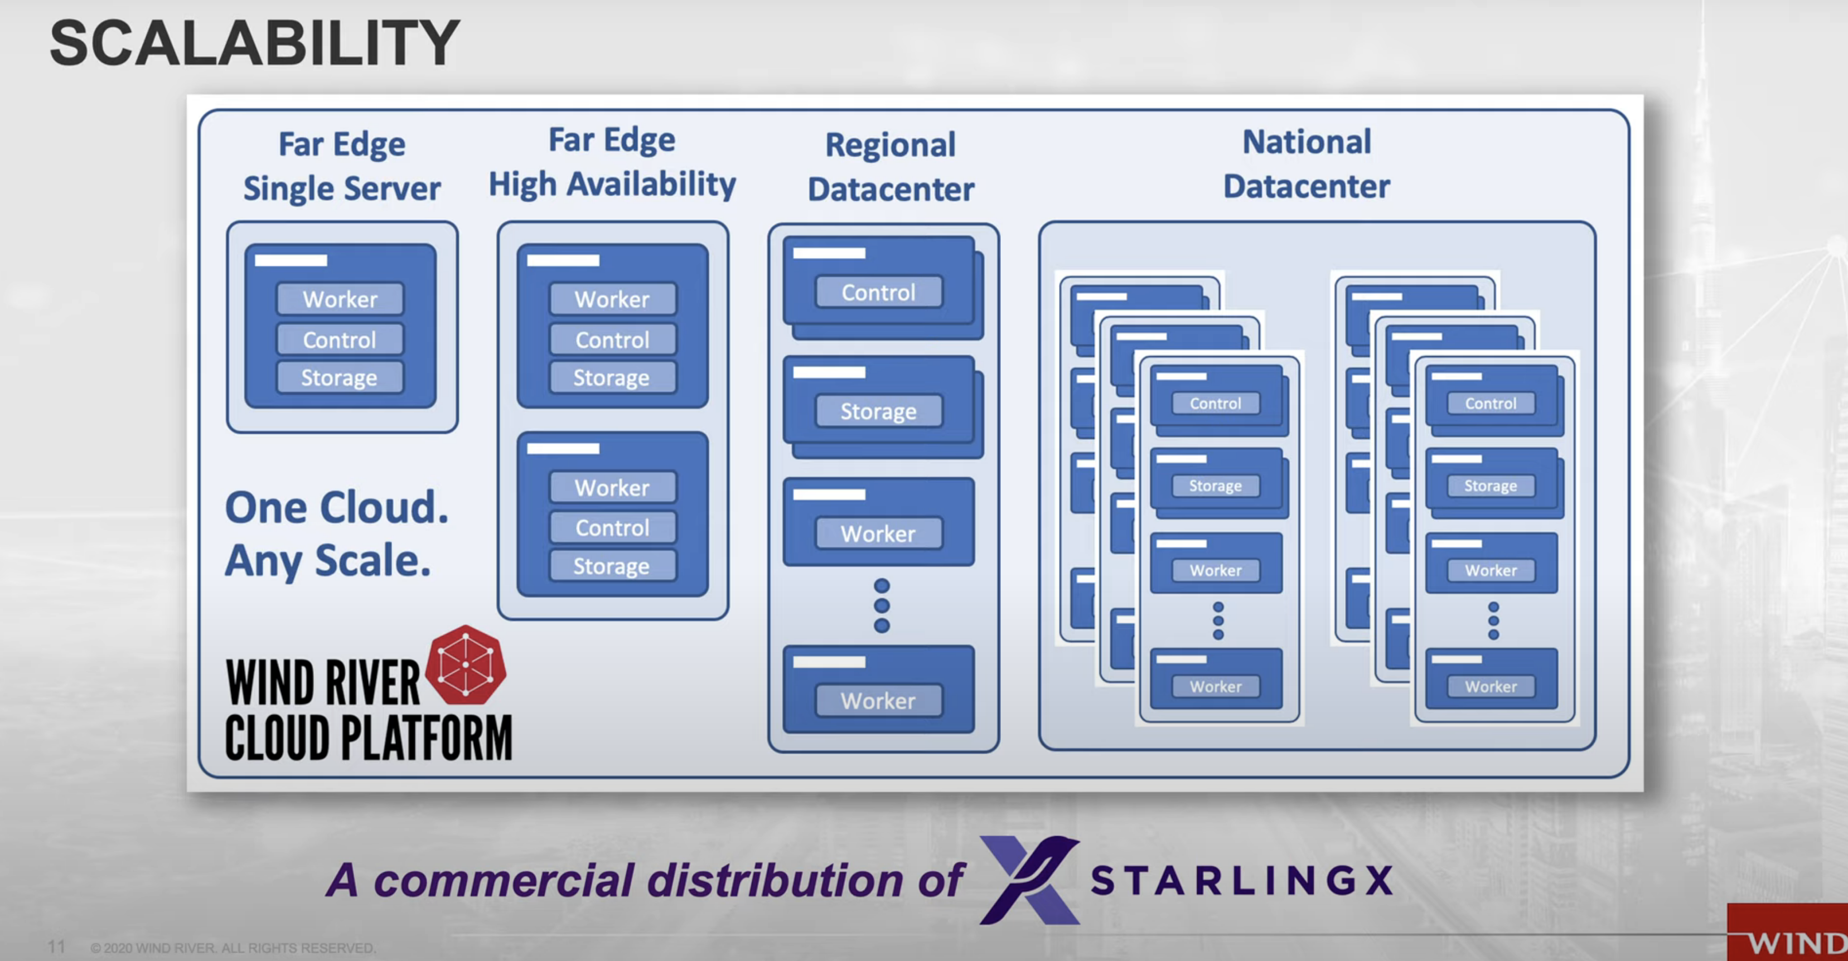
Use Cases
https://youtu.be/8I8TuQ1evKk
https://youtu.be/i9TPWE98KL8
https://wiki.akraino.org/display/AK/Akraino+Edge+Stack

Slide 7
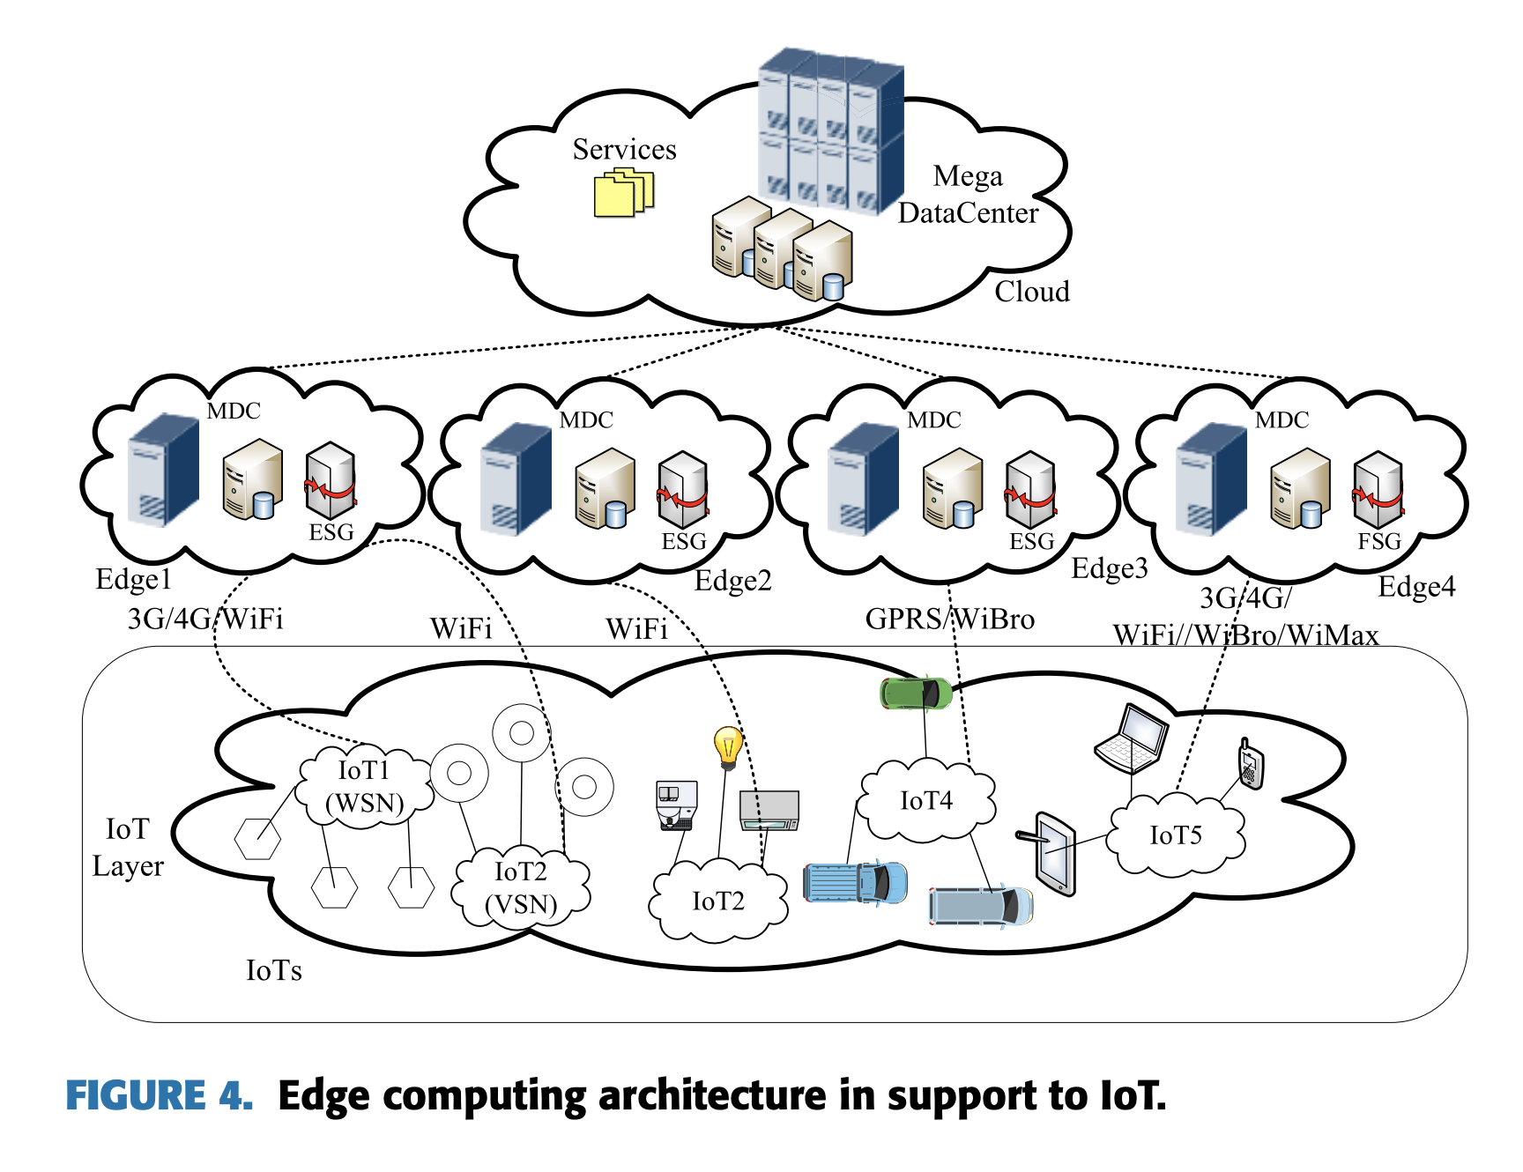
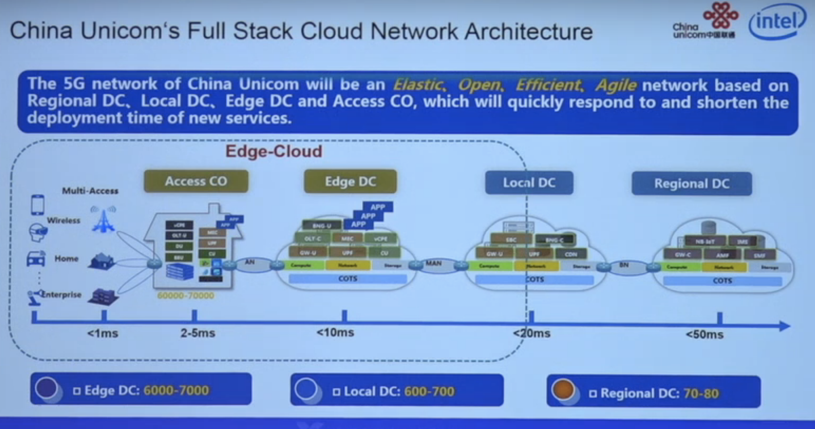
Use Cases Examples
https://youtu.be/1BM803fy5io
https://ieeexplore.ieee.org/iel7/6287639/8600701/08758431.pdf

Slide 8

Key Edge Requirement: Autonomous
Edge workloads continue functioning when
Edge-cloud network disconnect
Edge node down
Both 1 and 2 happen at the same time

Slide 9
Key Edge Requirements: Flexibility
Separate control from action, in each geographic region
Local > Global
Latency matters
Data locality & privacy
Global > Local
Regional analytics & policy

Slide 10
Edge Model
Cloud
Internet
Edge Data Center (Region x, AZ i)
Edge Data Center (Region y, AZ j)
Edge Data Center (Region z, AZ k)
Devices
Devices
Internet
Devices

Slide 11
Edge Model
Cloud
Internet
Edge Site
Edge Site
Edge Site
Edge Site
Edge Site
Devices
Internet
Edge Site
Devices
Devices
Devices

Slide 12
Cloud Control Plane
Cloud Node Pool
IoT Edge
EdgeCluster
Edge workloads continue functioning when
Edge-cloud network disconnect
Edge node down
Both 1 and 2 happen at the same time

Slide 13
Cloud Control Plane
Cloud Node Pool
IoT Edge
EdgeCluster
Cascading EdgeCluster

Slide 14

Mode 1:
Mode 2:
/c1/c11
/c1/c12
/c2
/c1/c11
/c1/c12
/c2
control
/c11
/c12
……
c1
/c21
/c22
……
c1
c2
Control?
c2
c11
c12
c11
c12
Best for: “Clusters on internet”
Best for: “Clusters on-prem within firewall”

Slide 15
Edge Cluster Provisioning
Option 1: Self-organizing

Slide 16
Edge Cluster Provisioning
Option 2: Attachment

Slide 17
Cloud Control Plane
San Francisco
Cloud Node Pool
Seattle
Bellevue
Salt Lake City
Bellevue Downtown
Grand Canyon
“East-west” inter-edge communication

Slide 18

3/24 (today)
3/31
POC feature tracking
Feature Scoping
Review
4/13
4/20
4/27
3/24 (today)
Community
Review
Discussion with Network Team
TSC
4/31
POC
Review
4/1
5/31
5/23
Design doc draft for 5/31
Feature Design
Review
KubeCon Abstract
7/31
5/6
Release Planning

Slide 19



Related Solutions – Type 1
IoT edge

Slide 20
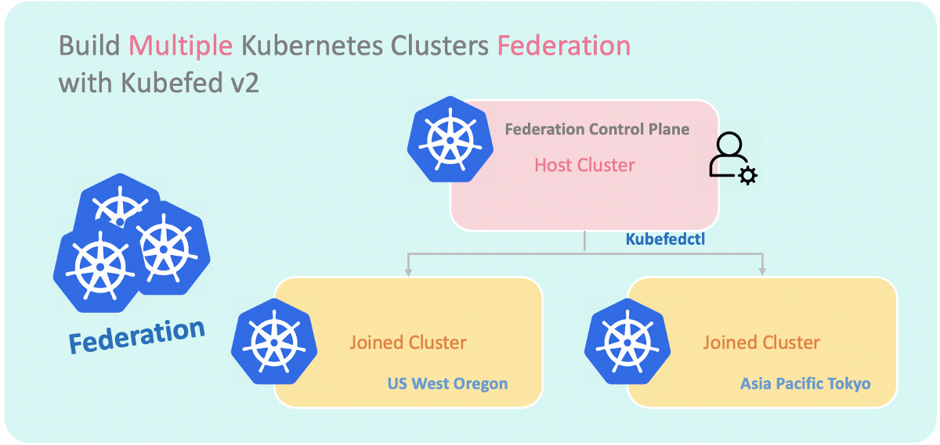


Related Solutions – Type 2
Federation v1, v2, , Cluster Registry

Slide 21
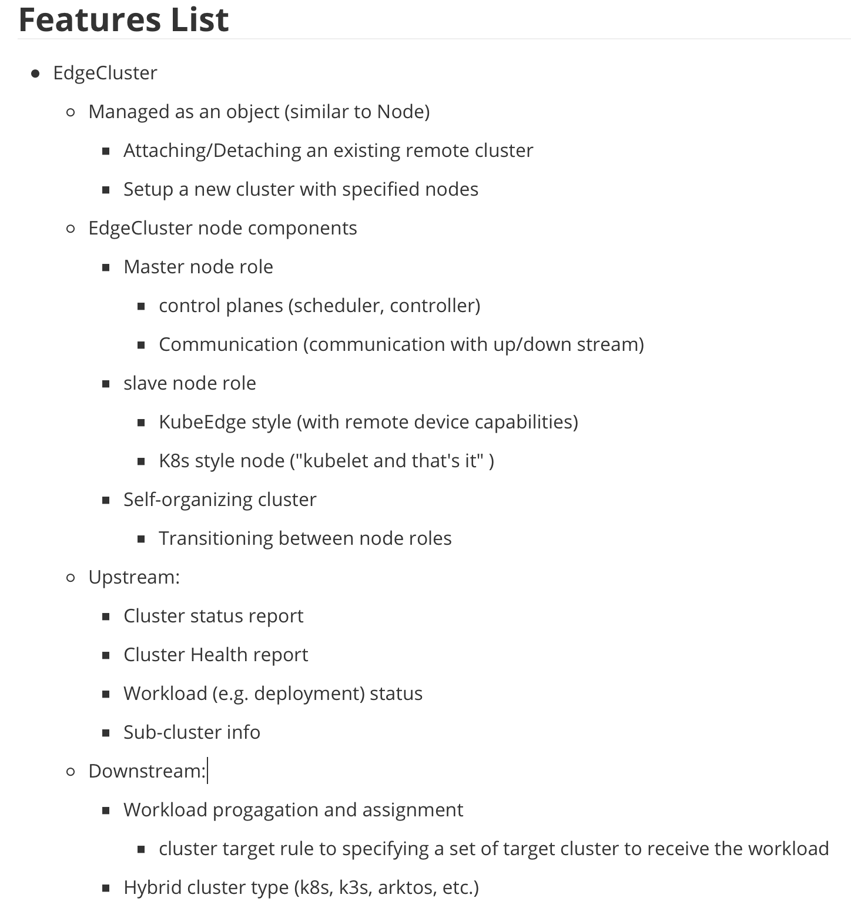
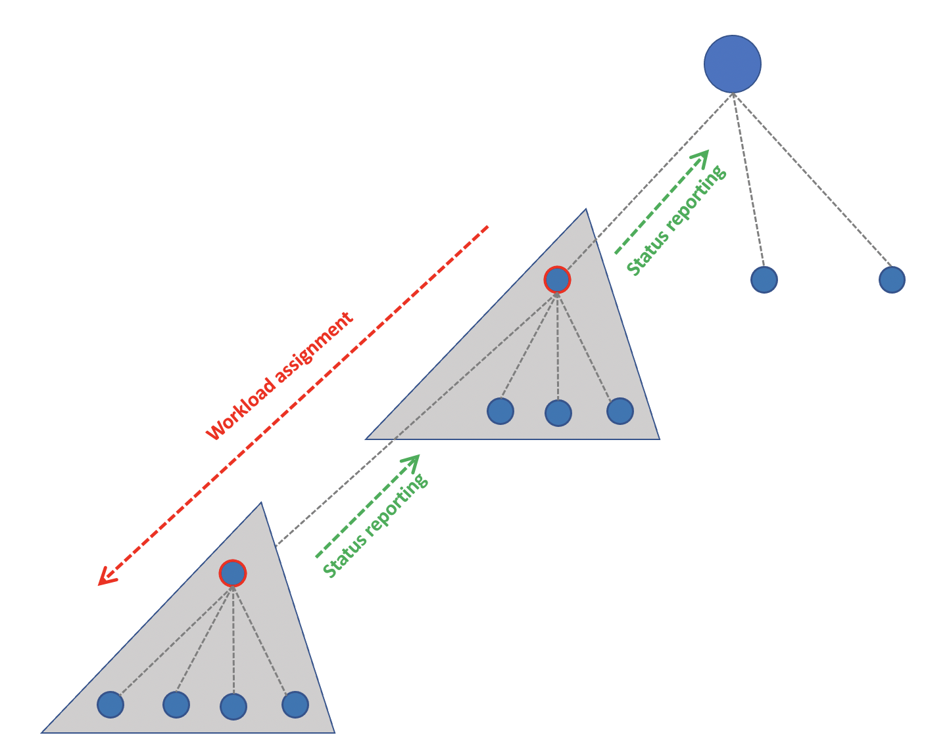

Slide 22
Question

